Slide 2
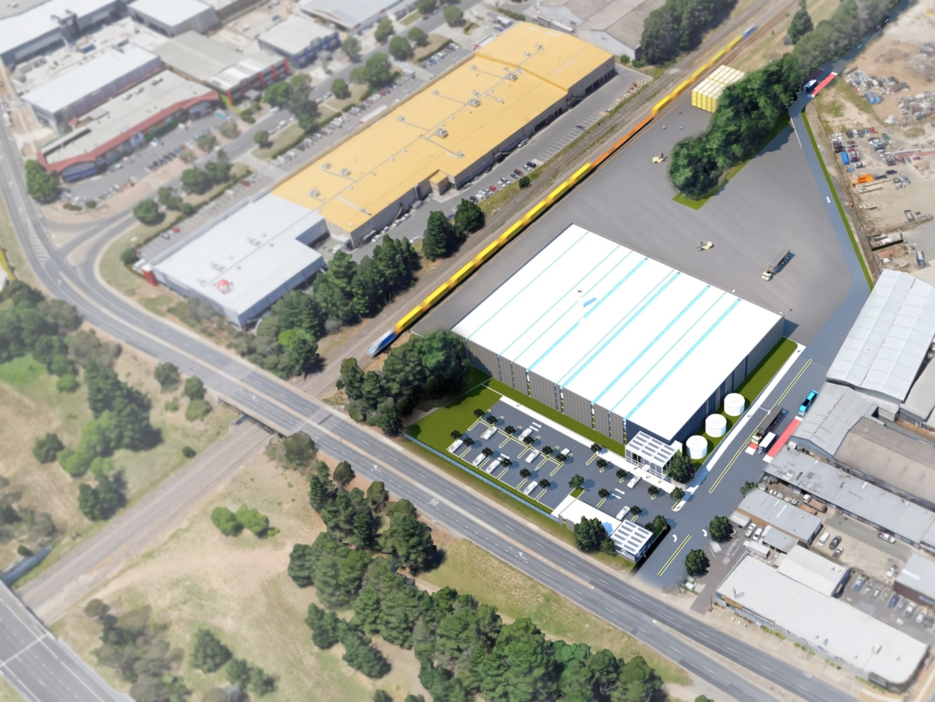
https://www.planning.act.gov.au/__data/assets/pdf_file/0006/1190895/DRAFT-EIS-201700053-01.pdf 26/05/2020
Truck freight terminal approved
Rail terminal
approved
Access Recycling
Harvey Norman retail
Tigerwaste
CRS
proposed
MRF shed 80m x 90m
EIS through DA to come
Allbids Auction House
Ipswich St
ACT rail corridor
Monaro Hwy
New truck activated traffic lights approved

