Slide 1
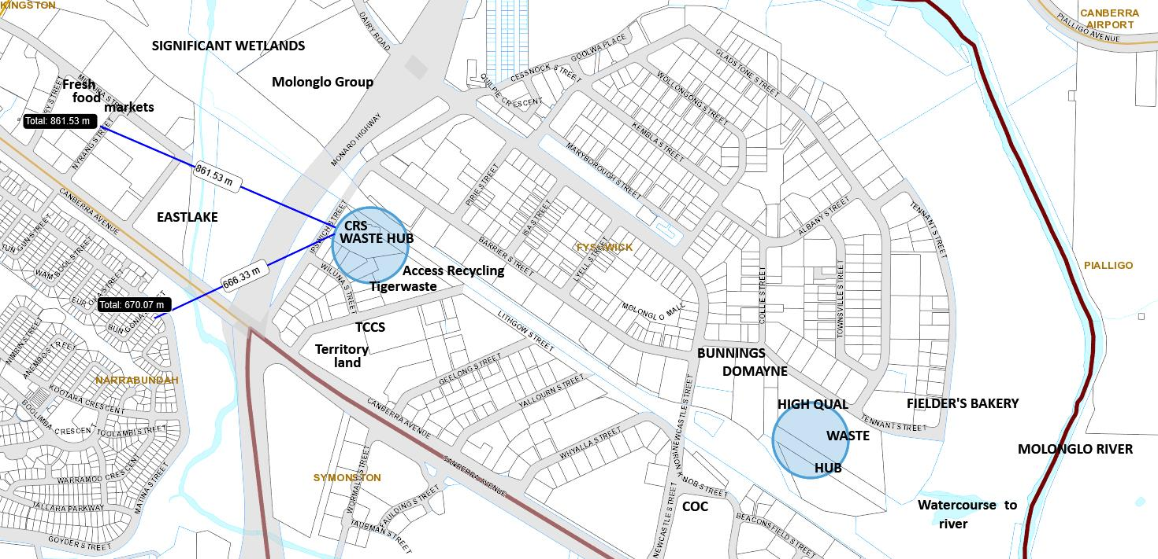
Canberra Airport
Runway less than 2km
Kingston Arts Centre
ACT MAPi – 26 May 2020

Slide 2
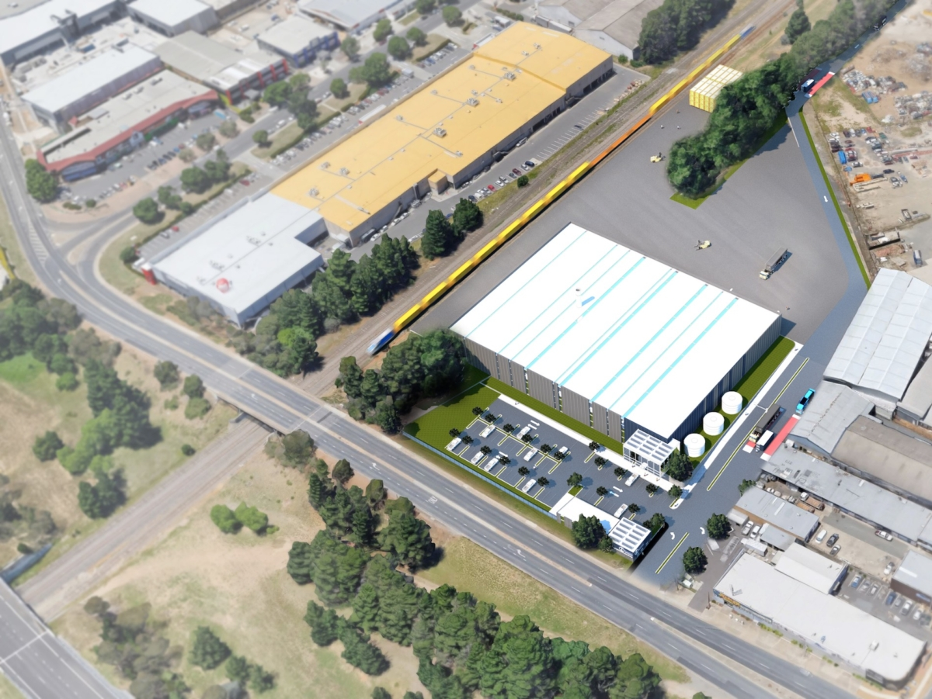
https://www.planning.act.gov.au/__data/assets/pdf_file/0006/1190895/DRAFT-EIS-201700053-01.pdf 26/05/2020
Truck freight terminal approved
Rail terminal
approved
Access Recycling
Harvey Norman retail
Tigerwaste
CRS
proposed
MRF shed 80m x 90m
EIS through DA to come
Allbids Auction House
Ipswich St
ACT rail corridor
Monaro Hwy
New truck activated traffic lights approved

Slide 3
ACCESS RECYCLING Zato GF-4000 shredder
Here the Zato shredder the same as that proposed for 15 Lithgow St receives a whole car which has been stripped and compressed.
Queensland distance guidelines for fragmentising machinery state 1500m distance from residents and “sensitive uses”.
The ACT guidelines for separation distance fail to identify End of Life Vehicle (ELV) fragmentising processing at all. ACT scrap metal facilities are to be only 500m distance from sensitive receptors.

Slide 4
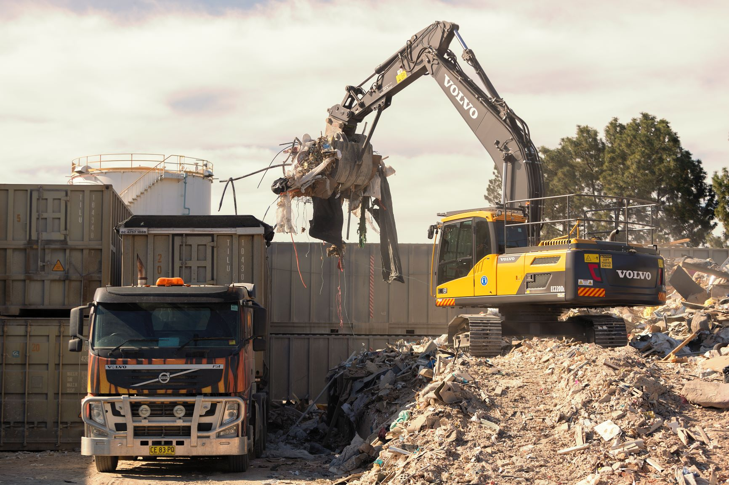
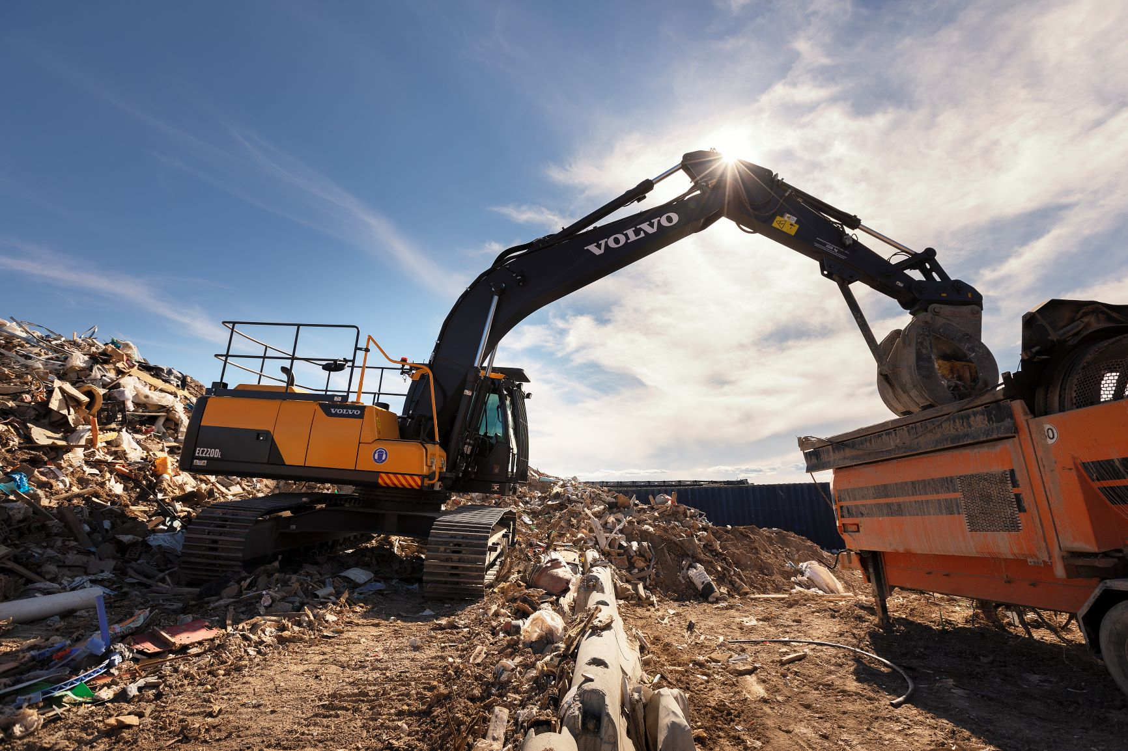
TIGERWASTE
at 13 LITHGOW St on the same block as Access Recycling and over the fence from CRS
https://www.tigerwaste.com.au/waste-transfer-station/ 20/05/2020
No existing EPA Authorisation available to be checked for compliance and health impacts.

Slide 5
Fires in metal recycling/processing facilities are common
This is one of 8 scrap metal fires since 2014 at 15 Lithgow St. Acrid air smelling of burnt plastic and tyres was still at Wiluna St the next day.
Approval to introduce fragmentisers will increase toxic dust emissions at this location which is at a distance of;
800m from the Fyshwick fresh food markets;
350m to the brewery and open air eating at 1 Dairy Rd;
700m approx. to Narrabundah residences;
500m approx. to the Southside Village;
3 childcare centres within one kilometre.

Slide 6
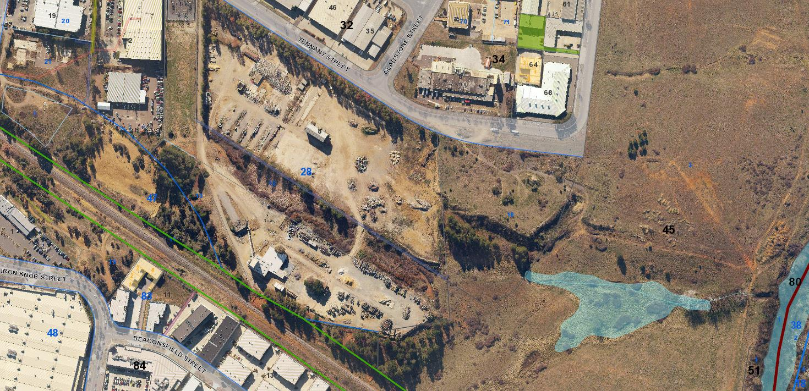
Government maps indicate adjacent wetland into the Molonglo River.
Bunnings
Domayne
Tennant St
Dirty Jane’s
Fielders’ Bakery
Hi Qual
waste hub
10 hectare
site
Rail line
Water course to river
Molonglo River

Slide 7
WHAT IS PEF ?
Processed engineered fuel production is just one of the 9 or so processes to be undertaken on the Tennant St site. Associated heavy vehicle movements just for PEF operations will be increased by 160,000 per year throughout Fyshwick
The dry waste of unknown content and from unknown source is pelletised for export to be incinerated in cement production, power stations or waste to energy facilities. The Tennant St factory is intended to become the largest PEF producer in Australia.

Slide 8
Federal Minister for the Environment at Wetherill Park with the PEF waste in the background. Fyshwick will be larger and the additional processes involve a range of waste streams trucked in.

Slide 9
PROCESSED ENGINEERED FUEL
The ACT’s recent Policy on Waste to Energy allows the production of PEF for incineration elsewhere.
At Wetherill Park 200,000 tonnes of dry commercial and industrial and mixed construction and demolition waste produces around 150,000 tonnes each year for burning in cement production.
At Tennant St the waste received for PEF production appears to add up to 450,000 tonnes per annum making this factory by far the largest in Australia.

Slide 10
WHAT CAN WE DO?
We are now entering the CRS proposal final stage which is the Development Application for the Materials Recovery Facility (MRF) at 16 Ipswich St Fyshwick.
The Environmental Impact Statement allowed by Planning Minister Gentleman against public opposition and expert opinion is not an approval process.
Make your representation count. There will be information available on the websites of the Inner South Canberra Community Council and the Fyshwick Business Association. The DA notification will be on EPSDD web under Fyshwick.
Refer to the ARUP Report in the EIS

